Slide 1
APA Ch. 4
Writing Style and Grammar

Slide 2
Effective Scholarly Writing
Goal: Advance knowledge on a particular subject
Traditional Forms: Dissertations/Theses, Journal Articles, Books

Slide 3
Effective Scholarly Writing
Level of Formality:
  Formal
  Semiformal
  Informal
Informal language == conversational, does not adhere to grammar rules, uses slang, etc.
Personal letters, social media, dialogue are all examples of informal language

Slide 4
What is Formal Writing?
Academic writers should use formal and semiformal writing styles, depending on the situation
What’s the difference?
  Semiformal == Grammar rules apply (e.g., no slang) but writing is more personal (reader friendly vocab, shorter sentences, personal tone, etc.)
    Example: Magazines like Smithsonian
  Formal == Conventional grammar rules plus serious tone
    Example: Journal articles

Slide 5
Rules of Formal Writing
Third person (no first-person or second-person)
Technical terms (readers are usually in the same field)
No contractions
Complex sentence structure

Slide 6
Continuity and Flow
Effective writing has continuity
  Logical consistency (ideas naturally progress across paragraphs)
Effective writing also has flow
  Smooth cadence of words
  Inconsistencies, omissions, and irrelevant information interrupt flow
Without continuity and flow, a work seems disorganized or scattered

Slide 7
Improving Continuity and Flow
Clearly articulate the links between concepts
Present ideas in a logical order
Example:
  Organizing a lit review chronologically (earliest studies to most recent)

Slide 8
Transitions
Use Transitions to improve the continuity and flow of your writing
Helps avoid choppy writing
Choppy writing my signal to the reader that you have abandoned a point or ended an argument prematurely.
Try to amplify discussion rather than immediately move to the next point

Slide 9
What Makes Writing Choppy?
Too many sentences with the same structure
  Usually too many short, simple sentences
  Example of simple structure (“He went, He had, He… etc.)
Problem w/ formal writing:
  Appears unsophisticated
  Ideas seem disjointed
Why is this a problem?
  Whole point of analytical writing is to link ideas together!

Slide 10
Choppy Writing Example (1)
“She took dance classes. She had no natural grace or sense of rhythm. She eventually gave up”
How to fix?
  Try showing logical connections between ideas
  Cause/Effect words or Contrast words

Slide 11
Fixing Choppy Writing
Cause and Effect Transitions:
  Directly link to related points; Good when discussing points sequentially
  Examples: “Because”, “Since”, “So”, etc.
Contrast Transitions:
  Useful when comparing differing points
    Did two researches come to different conclusions?
  Examples: “But”, “Yet”, “Although”, “While”

Slide 12
Fixing Choppy Writing
“She took dance classes. She had no natural grace or sense of rhythm. She eventually gave up”
“She took dance classes, but since she had no natural grace or sense of rhythm, she eventually gave up.”
“Although she took dance classes, she had no natural grace or sense of rhythm, so she eventually gave up.”

Slide 13
Choppy Writing Example (2)
“Bears emerge from hibernation in the spring. They wander through wetlands. They feed mainly on grass.”
How to fix?
  Join multiple actions by the same agent into one sentence
How?
  Conjunctions! (“and”, “but”, “so”, etc.)

Slide 14
Fixing Choppy Writing
“Bears emerge from hibernation in the spring. They wander through wetlands. They feed mainly on grass.”
“When bears emerge from hibernation in the spring, they wander through wetland and feed mainly on grass.”

Slide 15
Choppy Writing Example (3)
“Jesse Ventura has denied interest in running for the senate. Ventura is the former governor of Minnesota.”
How to fix?
  Try using appositives!
Appositives == clauses that add information about a noun

Slide 16
Fixing Choppy Writing
“Jesse Ventura has denied interest in running for the senate. Ventura is the former governor of Minnesota.”
“Jesse Ventura, the former governor of Minnesota, has denied interest in running for the senate.

Slide 17
Fixing Choppy Writing
“Jesse Ventura has denied interest in running for the senate. Ventura is the former governor of Minnesota.”
“Jesse Ventura, the former governor of Minnesota, has denied interest in running for the senate.

Slide 18
Choppy Writing Example (4)
“The boy asked his father a question. The boy was five years old. The question as about death.”
“The five-year-old boy asked his father a question about death.”

Slide 19
Choppy Writing Example (5)
“My aunt is very strict with my cousin. She expects her to study all the time.”
“My aunt is very strict with my cousin, expecting her to study all the time.”
Modifying phrase
  Note: Must describe a word in the sentence, otherwise the modifier is dangling…. (more on that later)

Slide 20
Choppy Writing Example (6)
“I was exhausted. I stared at the page. I was unable to comprehend a single word.”
“Exhausted, I stared at the page, unable to comprehend a single word.”

Slide 21
Choppy Writing
Finally, vary your writing!
Don’t just use simple subjects, but also don’t overuse complex sentences.
Balance is one of the most important aspects of effective writing!

Slide 22

Conciseness and Clarity
Only say what needs to be said in your writing!
The more frugal you are with your words, the more readable your papers will be.

Slide 23

“Fluffy” Writing
What counts as fluff?
  Anything off topic
  Contributes to the word count but doesn’t advance the argument or theory
  Extraneous details that bog down the reader

Slide 24
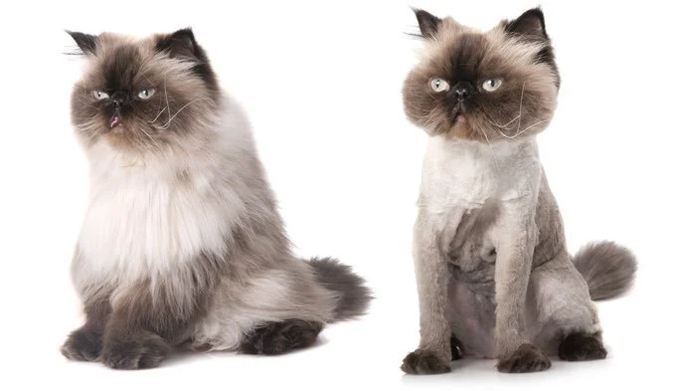
Eliminating Fluff
Planning! Make an outline and stick to it!
Active vs. Passive voice
Example:
  “Spacing out your study is an effective method to improve memory.”
  “Spaced study effectively improves memory.”
  (11 words vs. 5 words)

Slide 25
Eliminating Fluff
Remove cliches
  “On the other hand” vs. “Alternatively”
Check for redundancies
  “The idea of a cyberattack can leave us worried and frightened.”
  “The idea of a cyberattack can leave us paranoid.”

Slide 26
Where’s the Redundancy?
They were both alike.
There were four different groups of participants.
Participants sat in close proximity to one another

Slide 27
Where’s the Redundancy?
They were both alike.
There were four different groups of participants.
Participants sat in close proximity to one another.

Slide 28
Conciseness and Clarity
Myth: Writing concisely will make my paper too short.
Fact: Adding fluff to your paper will only make it convoluted and diluted, especially if the fluff isn’t directly related.
If you’re paper is still too short, expand the arguments. Add substance!

Slide 29
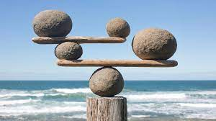
Conciseness
Balance is the key word!
Short word and sentences are easier to understand.
But...
  A long technical term might be more precise

Slide 30
Conciseness
Rule of thumb: Know your audience
Only include technical terms or jargon if you know your readers will be familiar with the terms
Otherwise, opt for simpler/more concise phrasing

Slide 31
Clarity
Be deliberate with your word choice! Every word has a purpose!
When possible, avoid using words with multiple meanings
  Example: Does significant mean “generally important” or refer to statistical significance?
Clarify meaning when necessary!

Slide 32
Tone
Descriptions/narrative sections should be linear and straightforward
Use language that conveys professionalism and formality
Don’t be combative!
  Example: “Buchanan (2019) did not address…” vs. “Buchanan (2019) completely overlooked…”

Slide 33
Tone
How to achieve the right tone?
Tip: Imagine a specific reader you intend to reach
  Write in a way that will inform/persuade them

Slide 34
Contractions
Don’t do it. (see what I did there?)
Too informal for scientific writing

Slide 35
Colloquialisms
Informal expressions used in everyday speech
Examples:
  “Gonna” vs. “going to”
  “very few”, “a little”, etc. when approximating quantity
Why?
  They can be interpreted different ways.
  Not precise!

Slide 36
Jargon
Specialized terminology unfamiliar to those outside of a specific group
Overuse of jargon hinders comprehension
  Even when the target audience is familiar w/ the jargon!
Why?
  Readers should be able to follow along and understand, even if they aren’t experts in your field!

Slide 37

Grammar and Usage
Incorrect grammar
Why?
  Distracting for the reader
  Can produce ambiguity
  Makes communication of ideas unclear

Slide 38
General Grammar Tips
Verb Tense should match within sentences
Use past tense when discussing other researchers’ work.
Why?
  The research has already been conducted!

Slide 39
Subject Verb Agreement
Verbs must agree in number, regardless of intervening phrases
Examples:
  The percentage of correct responses, as well as response speed, increases with practice
  A pair of animals was in each cage

Slide 40
Editorial “We”
Don’t use “We” to refer to people in general
  Incorrect: We typically study decision making in a lab setting
  Correct: Psychologists typically study decision making in a lab setting.
Why?
  Because its unclear who “we” is referring to

Slide 41
Singular “They”
Acceptable as a generic, gender neutral third person pronoun
Examples:
  Each participant turned in their questionnaires
  A child should learn to play by themselves.
  “He” and “she” should be reserved for talking about specific individuals

Slide 42
Sentence Construction
Subordinate conjunctions
  “While”, “Since”, “Although”, “Because”, etc.
  Used to introduce subordinate clauses
  Examples:
    Because researchers are interested in something, they study it in the lab.
    Although my memory is bad, I still remember to feed my dog.
    Setting goals may improve quality of life while reducing boredom.

Slide 43
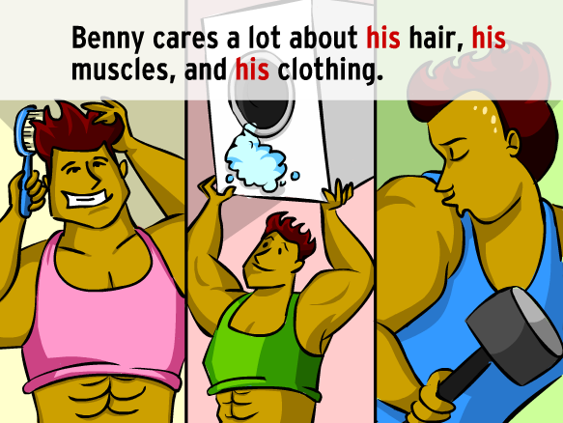
Parallel Structure
Presenting parallel ideas in a coordinated form
Helpful because it enhances a reader’s ability to follow along

Slide 44
Writing Tips
Reading! How do other authors structure their work?
Using an Outline! Helps you stay on topic (reduce fluff)
Rereading your draft! Especially effective after a long break

Slide 45
Revising your Paper
Is the central point or thesis clear?
Is the information well organized? Is the flow between ideas clear?
Does the draft meet the requirements for the assignment?
Is the writing grammatically sound?

